Slide 1
Software Engineering Practices at Amazon: Observations & Thoughts
Changjian Zhang

Slide 2
Development Process
Agile (Scrum), Activities, Artifacts
Notes:
I’ll first walk through the development process you would expect working as an engineer at Amazon. In general, Amazon is doing a standard Scrum process. I’ll focus on the development activities and artifacts, especially I’ll focus on design and analysis related activities and artifacts.

Slide 3
Software Development Process in Amazon
Scrum process
Roles:
Manager: Scrum master
PM & BA: product owner
Engineers: Development team
2 Weeks = Sprint
3 Sprints = Feature Delivery Cycle
Planning
Developing & CI/CD
Review
Retro
Notes:
Manager controls the development process to allocate resources internally and externally, coordinate across other teams, tracking the progress, monitor team operation metrics.
PM make feature requests but won’t affect the technical decision made by the engineers.
Development team has most of the power to make the right technical decisions for features, and also estimate the effort needed for features.

Slide 4
Planning Phase
Planning
Developing & CI/CD
Review
Retro
Meetings:
Sprint planning meeting
Task grooming meeting (planning poker)
Design review meeting
Artifacts & Data:
User stories, Tasks, and Backlog
Architecture design
Development schedule
Notes:
At Amazon, they have a strong focus on system design. For every feature, an engineer is responsible for creating a design for it.

Slide 5
Developing Phase
Planning
Developing & CI/CD
Review
Retro
Meetings:
Daily standup meeting
Whiteboard design session
Development activities:
Code commits
Code review
Testing & Static Analyzers
Automated CI/CD
Artifacts & Data:
Review discussions
Testing reports

Slide 6
Code Review, Static Analyzers, and Testing
An internal code review system (like GitHub).
Static analyzers:
Java Checkstyle plugin
Java SpotBugs analyzer
Internal analyzer for dependency vulnerabilities
Amazon CodeGuru Reviewer (advertised as program analysis + ML)
Internal Risk/Security issue detection analyzer
Testing platforms for integration, load, canary tests.
Notes:
So in general, Amazon use code review, static checkers, and testing to ensure the quality of the system.

Slide 7
Scrum Review Phase
Planning
Developing & CI/CD
Review
Retro
Meetings:
Feature/Task review meeting
Feature Launch/Demo meeting
Dashboard review
Artifacts & Data:
Updated backlog
Burndown chart
Review app operation data: throughput, error rate…
SOPs: standard operation procedures

Slide 8
Scrum Retro Phase
Planning
Developing & CI/CD
Review
Retro
Meetings:
Team/Org-level retro meeting
Administrative meeting
Artifacts & Data:
Kudos & Action items
Review team operation data:
Tickets
Risks
Development activities metrics (e.g., number of manual deploys)
Notes:
Retro is a great time to reflect how the team can improve the development process. Story: I was developing using a tool new to the team, so I follow the documented step to manually deploy the code to the beta phase. It triggers a warning in the team operation metrics that there was a spike in the number of manual deployment, which was 0 in the past.
Instead of just letting not manually deploy or turn off the warning, the team researched how this metric is collected, is it reasonable, and can we let it ignore manual deployment for projects that are not in production.

Slide 9
Thoughts
Agile, Formal methods, Software design & analysis, AI
Notes:
So I have briefly summarized the activities as an engineer at Amazon. Then, I’ll reflect on what I think about the engineering practices, what works well, what can be improved, what are the insights for my own research.

Slide 10
How Agile Manifesto is Respected?
Individuals and interactions over processes and tools
Interactions and communications via various meetings, whiteboard sessions, pair programming.
But also processes and tools to support communication, logging, knowledge sharing.
Need interactions but also keep them in record!
Working software over comprehensive documentation
Surprisingly more documents than you would expect, Wiki, design doc, planning & tracking docs, SOPs.
Various testing, static analysis, CI/CD support to ensure quality and facilitate fast delivery.
Notes:
1. So its

Slide 11
How Agile Manifesto is Respected?
Customer collaboration over contract negotiation
Customer Obsession.
Team B is Team A’s customer; Away Team.
Responding to change over following a plan
Business plan (OP1, OP2) over development plan.
Feature take-in time window.
More like incremental development but review the plan every two weeks.

Slide 12
Conway’s Law and More…
Organization structure defines system design.
Everything (including business goal, management, development process, tooling, …) defines the code.
By following the process, everyone produces the same, high-quality code. (Interestingly, you won’t find comments on code.)
Notes:
Code as comment is the result of design doc, meetings, design patterns, strict code standard, and static checkers.
The use of Lambda and serverless is the result of logically simple program needs to run in scale.
The change in organization structure is the result of change in business goal, e.g., BAD has extended its business functionality from only addressing bad actors.

Slide 13
High Quality Code? But…
Meetings, Meetings, Meetings! 40% ~ 50% time in meetings!
Good for knowledge sharing but not efficient for everyone.
Great documentation on requirements, design, review, etc.
Not all the artifacts are up-to-date.
Does not meet CMU standard ☹
Apply various techniques for ensuring code quality such as static checkers.
Sometimes conflicting configurations are found.
E.g., require using this keyword in one project but not in another.
Cover coverage seems to be arbitrarily defined.
Notes:
I’m not saying the meetings are useless. In fact, I think they are really helpful and the documentation generated from these meetings are important. However, I don’t think they are in the right format. If a lot of the engineers are working on their own jobs in a meeting, then we should rethink the format and the purpose of that meeting.

Slide 14
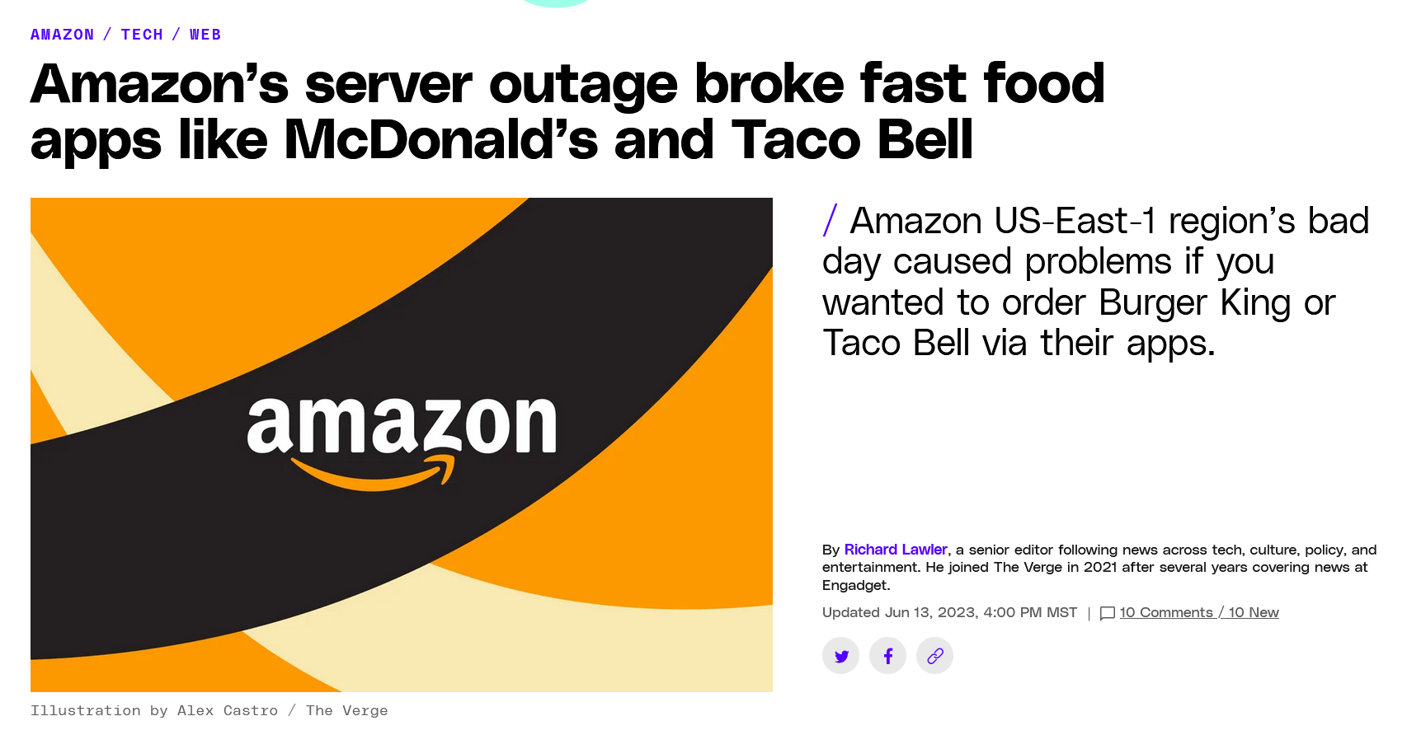
AWS Outage on Jun 13, 2023
Notes:
A lot of internal services as well as customer services are affected. Nightmare for oncall engineers, but at the same time, a lot of interns (some full-time engineers) are posting memes in the Slack channel. Ironically, later, Slack was also affected and some of its services were in degraded mode. Not sure if this was related to increasing volume of Slack because of the memes, but…
Even more memes were posted LOL.

Slide 15
Takeaway 1
All such activities, documentations, static checkers can indeed help improve software quality.
But how to conduct them correctly?
It’s an ad-hoc and experimental process to decide on the “correct” process for an organization.
Notes:
What’s the current status on software development process research? Do we have an SOP for organizations to help them build their most suitable process.

Slide 16
Formal Methods in AWS
AWS hires a lot of formal methods researchers.
Research focus:
Program analysis
Access control, Security policy
Program verification (Rust)
Distributed algorithm/protocol verification (Dafny, P)
Business rationale:
Crucial building blocks for cloud infrastructure
Complexity cannot be easily handled by engineers
Benefit > Cost

Slide 17
CRUD-like Applications are Easy?
...
// Write message to database for auditing.
this.DynamoDBClient.save(message);
// Publish message to message queue.
this.SQSClient.publish(message);
...
...
// Publish message to message queue.
this.SQSClient.publish(message);
// Write message to database for auditing.
this.DynamoDBClient.save(message);
...
For a Lambda function triggered by SQS, the message will become available again if the function fails, so your function code must be able to process the same message multiple times.
Notes:
The happy case is simple. If save fails, the left one would not have any record and publish any data; the right one would publish the data.
However, SQS by default would retry. So the left one would try save the same record multiple times, it should not unexpected side-effect, like multiple same records.
The right one would publish the data multiple times, would it affect the downstream functions?

Slide 18
Why my tests failed with “Rate exceeded”?
Error: “Lambda rate exceeded error.”
Root cause: Lambda reserved concurrency = 1
Reserved concurrency sets the max allowed concurrent instances of a Lambda function.
Possible solutions:
The team uses “1” in other projects satisfying the production use cases. Add sleep in integration tests.
Change it to an arbitrary number greater than 1.
Change it to 5?!
✓
https://aws.amazon.com/blogs/compute/understanding-how-aws-lambda-scales-when-subscribed-to-amazon-sqs-queues/
Notes:
From the error message, my guess is I reach the limit of allowed concurrent instances of Lambda. But it’s just a simple integration tests with less than 10 requests? Isn’t Lambda supposed to scale and handle them!
Root cause: the integration tests first test the upstream function which would later trigger the downstream function, then the tests directly invoke the downstream lambda, so the downstream lambda may have a concurrency greater than 1.

Slide 19
“It does not work on my side!”
Error: “n.text is not a function.”
Fun facts:
This issue happened right after I presented the demo. The demo was working well!
No one in our developing team can reproduce it!
Root cause: Wrong permission configuration. The users were not authorized even though we thought they were.

Slide 20
Takeaway 2
Software design and analysis is hard even for CRUD-like systems.
Due to the increasing complexity of underlying platforms, frameworks, libraries, and configurations.

Slide 21
Moving towards the AI Era?
I feel I’m a human when I’m in various planning, design, review meetings ☺;
I feel I’m a robot when I’m coding ☹.
Extensive structured docs
AWS-based architecture patterns
Reviewed, checked, highly similar code
Invaluable assets for the AI era
Notes:
When I’m clear what to work on, and after I learned the techniques I’m going to use. The coding part becomes copy-paste from existing code base. Because everyone writes the same code, understanding and finding code for similar functionality becomes easy.

Slide 22
Takeaway 3
Looking ahead to the AI era: Coding vs. Generation.
Documentation once disregarded becomes invaluable wealth?

Slide 23
Summary
Various development activities, documentations, tools can improve software quality, but need to be done in a correct way.
CRUD applications are not easy. Bugs are often due to wrong requirements, design, configuration.
With AI, process and documentation may become more important than coding.
Notes:
Might be biased here, but academia and industry should focus more on requirements, specifications, and designs, instead of just code.

Slide 24
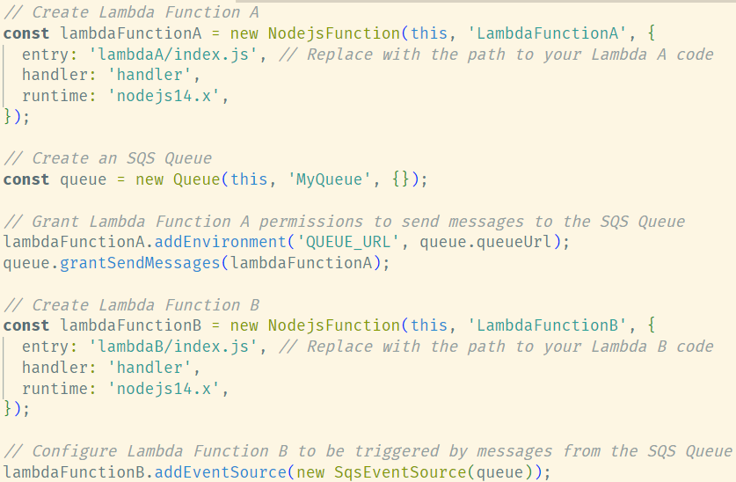


IaC to AaC?
Lambda A
MyQueue
Lambda B

Slide 25
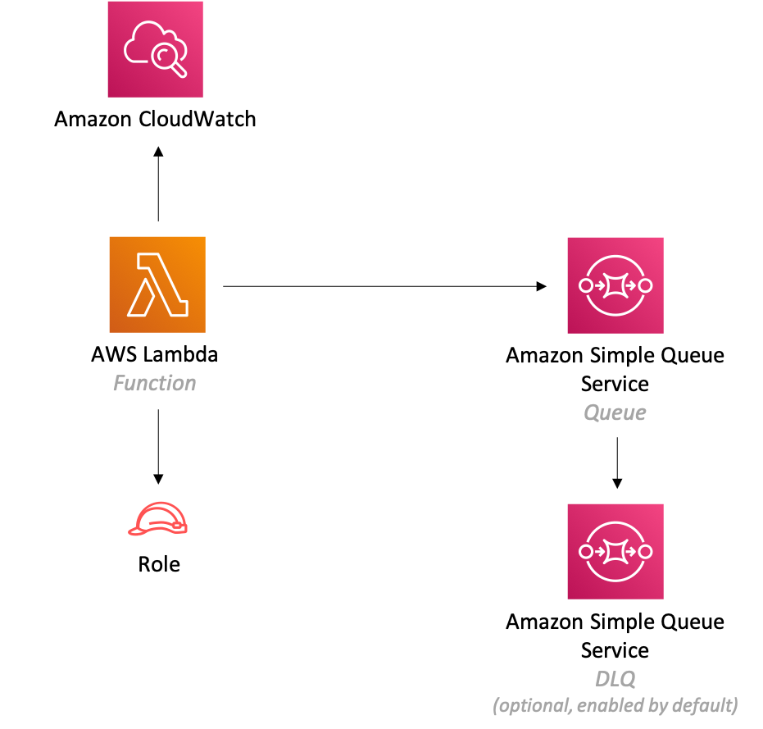
A Typical AWS Lambda Architecture

